Slide 1
An Analysis for
the Prediction of
Protein Subcellular
Localization
Group 7
Wei Meng, Yaoxiang Li, Zewei Xiong

Slide 2
Introduction
Background
As a result of large-scale genome sequencing efforts in recent years, protein data has accumulated in public data banks at an increasing rate. Subcellular localization is a key functional attribute of a protein
Knowledge of the subcellular localization of a protein can significantly improve the target identification during the drug discovery process
Usually considered as a multi-label classification problem

Slide 3
Introduction
Popular methods
Basic Local Alignment Search Tool (BLAST)
This method gathers the homologous proteins’ function information by searching the query sequence against the existing protein databases as it contains experimentally determined protein function information
Network based methods
These methods are under the assumption that interacted proteins share similar functions

Slide 4
Methods
Data description
The proteomics dataset was summarized by the SWISS-PROT database by which obtained extracting all animal, fungal and plant protein sequences
The dataset contains 5959 proteins annotated to one of 11 different subcellular lo-cations
Protein Type | Number of Sequences | Protein Type | Number of Sequences
chloroplast | 449 | mitochondrial | 510
cytoplasmic | 1411 | nuclear proteins | 837
ER proteins | 198 | peroxisomal | 157
extracellular proteins | 843 | plasma membrane | 1238
Golgi apparatus | 150 | vacuolar proteins | 63
lysosomal | 103 | Total | 5959

Slide 5
Methods
Data pre-process
protein sequences were truncated to length 401 to reduce computational time
truncated by removing from the middle of the protein as both the N- & C-terminal regions
Binary classification; three classes classification; four classes classification
80% train data and 20% test data
100-fold cross validation

Slide 6
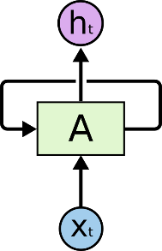

Methods
Recurrent Neural Networks have loops
An unrolled recurrent neural network

Slide 7
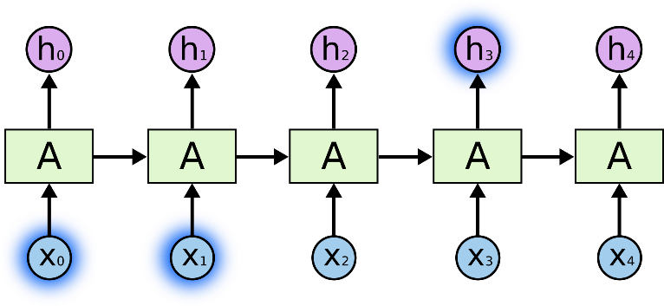
Methods
e.g., If we are trying to predict the last word in “the clouds are in the sky,” we don’t need any further context – it’s pretty obvious the next word is going to be sky. In such cases, where the gap between the relevant information and the place that it’s needed is small, RNNs can learn to use the past information.

Slide 8
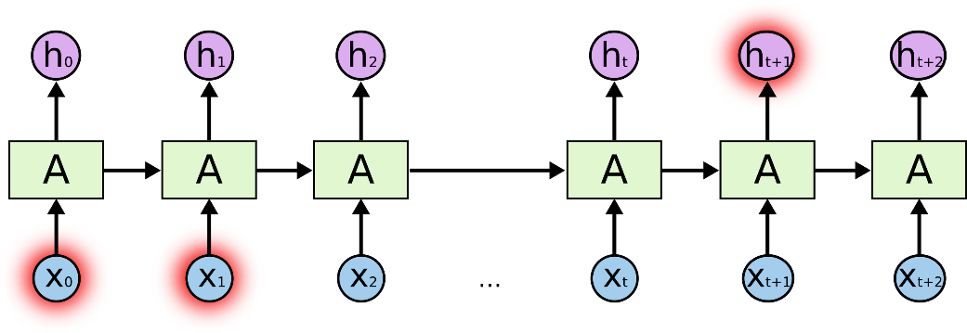
Methods
In theory, RNNs are absolutely capable of handling such “long-term dependencies”. the problem was explored in depth by Hochreiter (1991) who found some pretty fundamental reasons why it might be difficult.

Slide 9
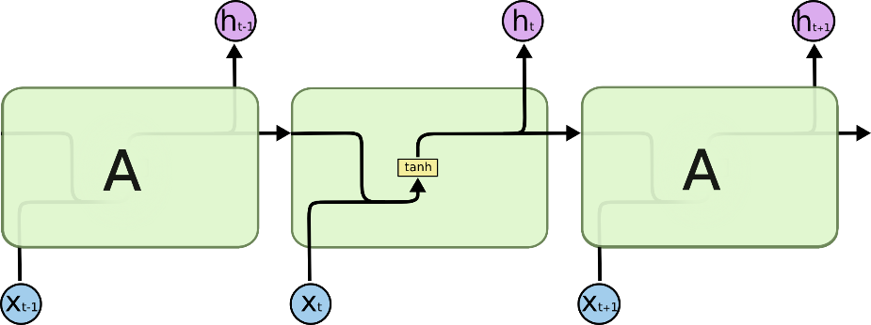
Methods
The repeating module in a standard RNN contains a single layer.

Slide 10


Methods

Slide 11

Methods
The first step in our LSTM is to decide what information we’re going to throw away from the cell state.

Slide 12

Methods
This step is to decide what new information we’re going to store in the cell state. This has two parts:
a sigmoid layer called the “input gate layer” decides which values we’ll update
a tanh function creates a vector of new candidate values that could be added to the state. In the next step, we’ll combine these two to create an update to the state

Slide 13

Methods
It’s now time to update the old cell state, C_{t−1}, into the new cell state C_{t}.The previous steps already decided what to do, we just need to actually do it
We multiply the old state by f_{t}, forgetting the things we decided to forget earlier. Then we add . This is the new candidate values, scaled by how much we decided to update each state value

Slide 14

Methods
Finally, we need to decide what we’re going to output. This output will be based on our cell state, but will be a filtered version
we run a sigmoid layer which decides what parts of the cell state we’re going to output
we put the cell state through tanh and multiply it by the output of the sigmoid gate, so that we only output the parts we decided to

Slide 15
Methods
See how LSTM works
input gate:
forget gate:
output/exposure gate:
new memory cell:
final memory cell:

Slide 16
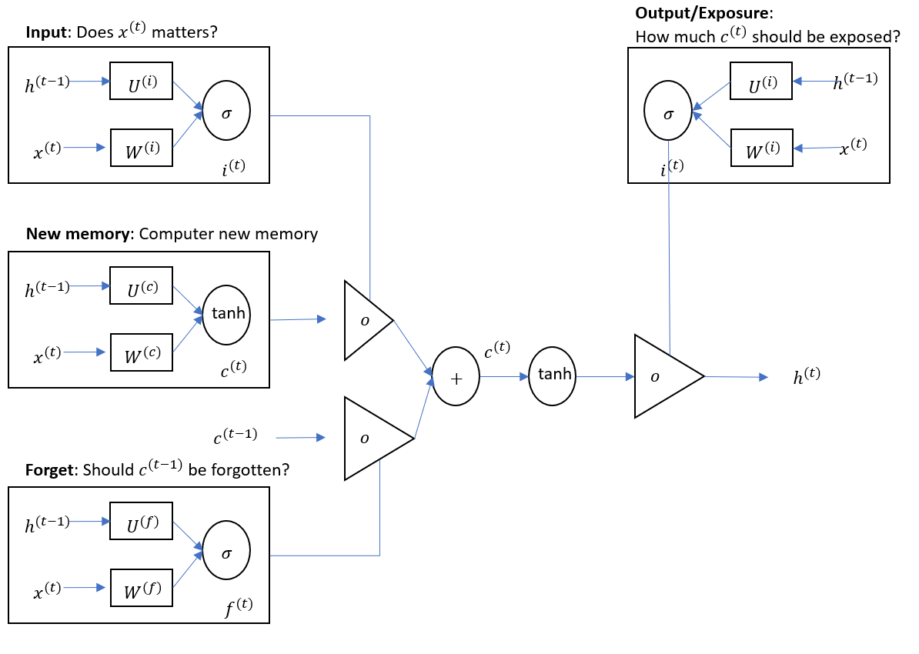
Methods
The detailed internals of a LSTM

Slide 17
Methods
Bi-directional Long Short Term Memory network (Bi-LSTM)
extend the unidirectional LSTM networks by introducing a second layer
the hidden to hidden connections flow in opposite temporal order
these two sub-layers compute forward and backward hidden sequences and respectively

Slide 18
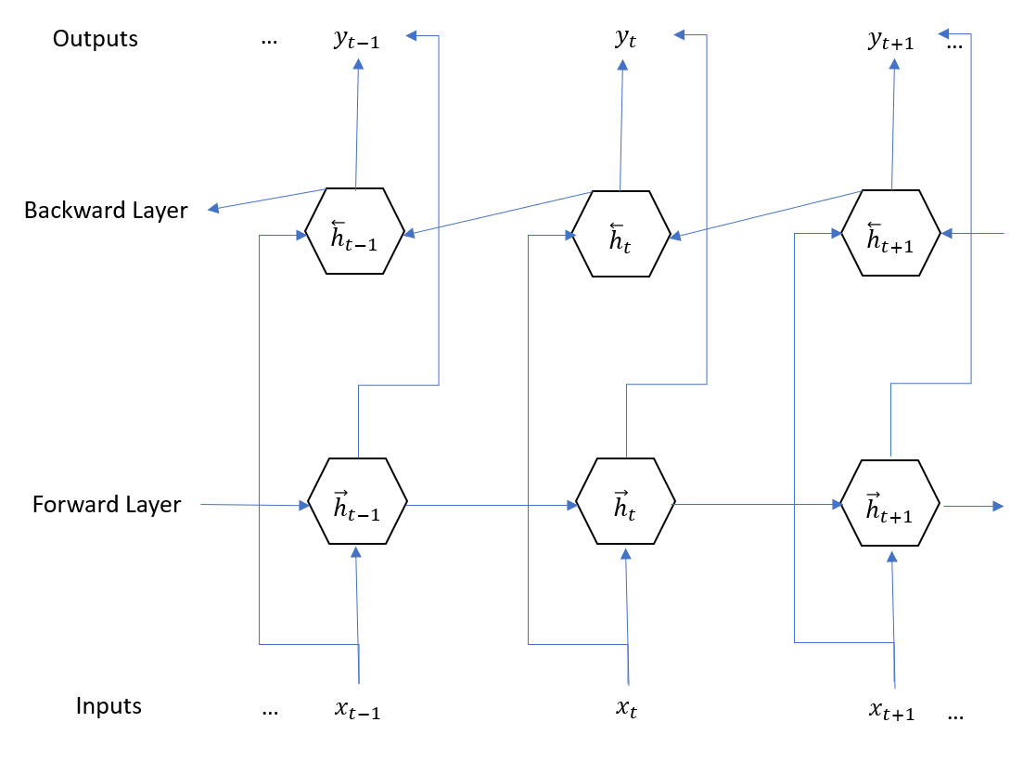
Methods
Architecture of a Bi-LSTM
-
-
-

Slide 19
Methods
Gated recurrent units (GRU)
although RNNs (Recurrent Neural Network) can theoretically capture long-term dependencies, they are very hard to actually train to do this
GRU are designed in a manner to have more persistent memory
make it easier for RNN to capture long-term dependencies

Slide 20
Methods
See how GRU works
: the relationship to compute the hidden layer output features at each time-step t
: the word vectors corresponding to a corpus with T words
- : input word vector at time t
GRU uses and to generate the next hidden state
- update gate:
- reset gate:
- new memory:
- hidden state:

Slide 21
Methods
Experimental Setup
Loss function
Optimization method and learning rate: Adam algorithm,
learning rate=0.1, beta1=0.9, beta2=0.999, epsilon=1e-08
Size of RNN hidden state: 2000, number of layers in RNN is 1 or 4
Dropout design and probability: p=0.6; initial weights were sampled uniformly distributed from the interval [-0.2, 0.2]
Environment:
NVIDIA Graphics Drivers v375.66, NVIDIA CUDA Toolkit v8.0, NVIDIA cuDNN v5.1, Python3 v3.5.2, Tensorflow v1.4, NumPy v1.13.3, pandas v0.20.3, Matplotlib v2.1.0

Slide 22
Results
1. Proteins visualization
visualizing the 11 types of protein to see the different distribution pattern of amino acids for each protein
here we put the visualization plots of cytoplasm, nucleus, plasma membrane and extracellular proteins

Slide 23

Results
1. Proteins visualization
cytoplasm
magnify the selected part
the proportion of yellow color is large

Slide 24

Results
1. Proteins visualization
nucleus
magnify the selected part
the proportion of pink color is large

Slide 25

Results
1. Proteins visualization
plasma membrane
magnify the selected part
the proportion of green color is large; color green concentrates on the start end

Slide 26
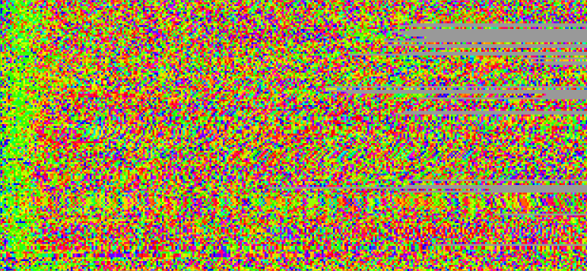
Results
1. Proteins visualization
extracellular
magnify the selected part
the proportion of green and pink is large; color green concentrates on the start end

Slide 27
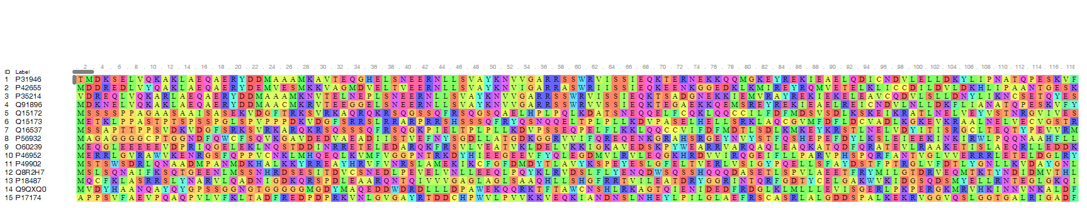
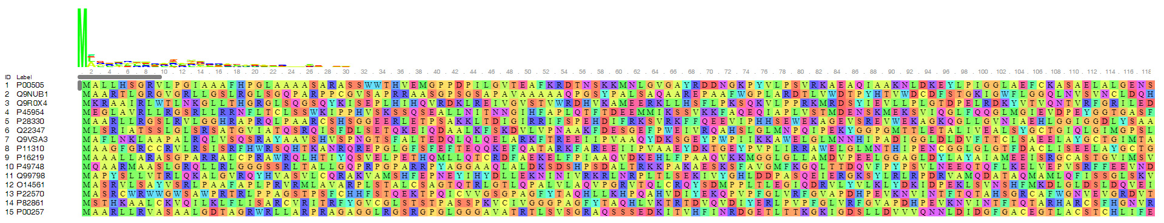
Results
1. Proteins visualization
- cytoplasm
- nucleus

Slide 28
Results
2. Performance of GRU, LSTM, Bi-LSTM model on test dataset
Binary classification
In general, all models performed well in this case as the high accuracy, precision, recall and F1 score which were around 0.9 and the highest value can be reached is 0.986
classify chloroplast vs. plasma membrane and chloroplast vs. cytoplasmic: Bi-LSTM model performed better than the other two
classify chloroplast vs. nuclear, ER vs. plasma membrane, ER vs. cytoplasmic and ER vs. nuclear, GRU performed better than the other two
 | Binary classification | Accuracy | Precision | Recall | F1 Score
LSTM | chloroplast & plasma membrane | 0.899 | 0.818 | 0.744 | 0.780
Bi-LSTM |  | 0.985 | 0.958 | 0.933 | 0.945
GRU |  | 0.896 | 0.818 | 0.900 | 0.857
LSTM | chloroplast & cytoplasmic | 0.950 | 0.953 | 0.976 | 0.964
Bi-LSTM |  | 0.967 | 0.973 | 0.986 | 0.979
GRU |  | 0.912 | 0.945 | 0.841 | 0.890
LSTM | chloroplast & nuclear | 0.856 | 0.964 | 0.769 | 0.856
Bi-LSTM |  | 0.928 | 0.931 | 0.909 | 0.920
GRU |  | 0.943 | 0.931 | 0.929 | 0.930
LSTM | ER & plasma membrane | 0.768 | 0.748 | 0.777 | 0.762
Bi-LSTM |  | 0.882 | 0.899 | 0.865 | 0.882
GRU |  | 0.916 | 0.951 | 0.858 | 0.902
LSTM | ER & cytoplasmic | 0.922 | 0.959 | 0.878 | 0.917
Bi-LSTM |  | 0.923 | 0.938 | 0.882 | 0.909
GRU |  | 0.957 | 0.979 | 0.959 | 0.969
LSTM | ER & nuclear | 0.910 | 0.979 | 0.909 | 0.943
Bi-LSTM |  | 0.907 | 0.952 | 0.866 | 0.907
GRU |  | 0.946 | 0.979 | 0.936 | 0.957

Slide 29
Results
2. Performance of GRU, LSTM, Bi-LSTM model on test dataset
Three classes classification
In general, all models performed well in this case as precision, recall and F1 score were around 0.85
LSTM model performed a bit better than the other two
 | cytoplasm |  |  |  | plasma membrane
LSTM | precision* | 0.875 | precision | 0.842 | precision | 0.833
 | recall | 0.827 | recall | 0.809 | recall | 0.791
 | F1 score | 0.851 | F1 score | 0.830 | F1 score | 0.812
Bi-LSTM | precision | 0.857 | precision | 0.825 | precision | 0.817
 | recall | 0.792 | recall | 0.753 | recall | 0.751
 | F1 score | 0.823 | F1 score | 0.787 | F1 score | 0.782
GRU | precision | 0.860 | precision | 0.841 | precision | 0.841
 | recall | 0.815 | recall | 0.777 | recall | 0.779
 | F1 score | 0.837 | F1 score | 0.808 | F1 score | 0.809
*In multi-label classification, precision and recall refers to the micro precision and micro recall. F1 score is the harmonic average of them.

Slide 30
Results
2. Performance of GRU, LSTM, Bi-LSTM model
Four classes classification
In general, all models performed well in this case as most precision, recall and F1 score values were around 0.9
In this case, Bi-LSTM model perfromed a bit better than the other two
 | cytoplasm |  | nucleus |  | plasma membrane |  | extracellular
LSTM | Precision* | 0.791 | precision | 0.805 | precision | 0.791 | precision | 0.868
 | recall | 0.834 | recall | 0.788 | recall | 0.778 | recall | 0.753
 | F1 score | 0.812 | F1 score | 0.796 | F1 score | 0.784 | F1 score | 0.807
Bi-LSTM | precision | 0.886 | precision | 0.870 | precision | 0.870 | precision | 0.890
 | recall | 0.849 | recall | 0.815 | recall | 0.817 | recall | 0.783
 | F1 score | 0.867 | F1 score | 0.842 | F1 score | 0.843 | F1 score | 0.833
GRU | precision | 0.817 | precision | 0.830 | precision | 0.817 | precision | 0.886
 | recall | 0.856 | recall | 0.814 | recall | 0.806 | recall | 0.783
 | F1 score | 0.836 | F1 score | 0.822 | F1 score | 0.811 | F1 score | 0.831
*In multi-label classification, precision and recall refers to the micro precision and micro recall. F1 score is the harmonic average of them.

Slide 31
Conclusions & Discussion
Conclusion
protein visualization is an effective way to see the distribution pattern of amino acids for each protein
GRU model, LSTM model, and bi-directional LSTM model are practical approaches to perform the prediction of the subcellular localization of proteins for binary classification, three categories classification and four categories classification
Discussion
Did not consider 11 categories due to computational complexity
consider batch-normalization in further study to avoid over-fitting problem
small data size compared with the number needed for general deep learning model - consider data augmentation mechanism/transfer learning

Slide 32
Thank you!

